Slide 1

多米体验课，We are back, And Are you coming?
听说你玩 “农药”，Do you want to create you own “农药”. I believe Dom Tech is Your choice
多米科技 ~Dom Tech
Pay your Taxi
Expense
Understand
company
requirements
Experience VR
I want In
了解游戏公司对人才的需求
Just Three days
0315-2172239
Create your
Own
Game
QQ: 3234269255
Now
Create you Own
mobile game
Dom Tech
www.domschool.cn
地址：高新区大陆阳光102楼705室

Slide 2

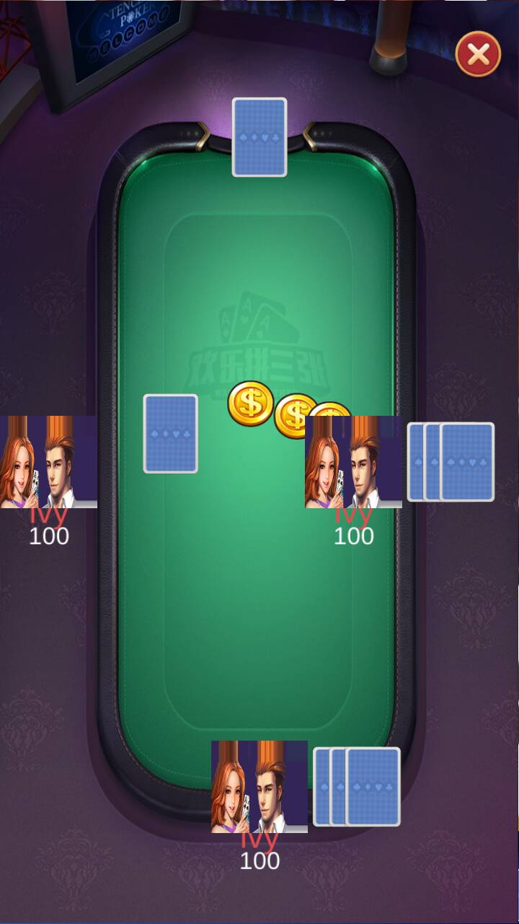
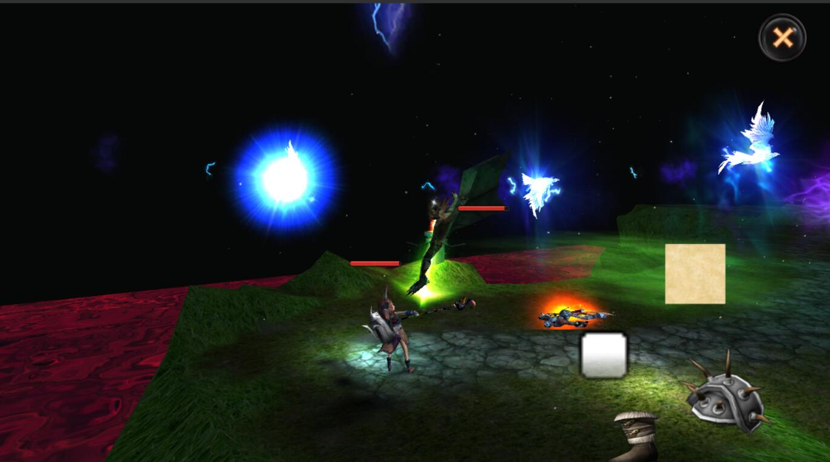

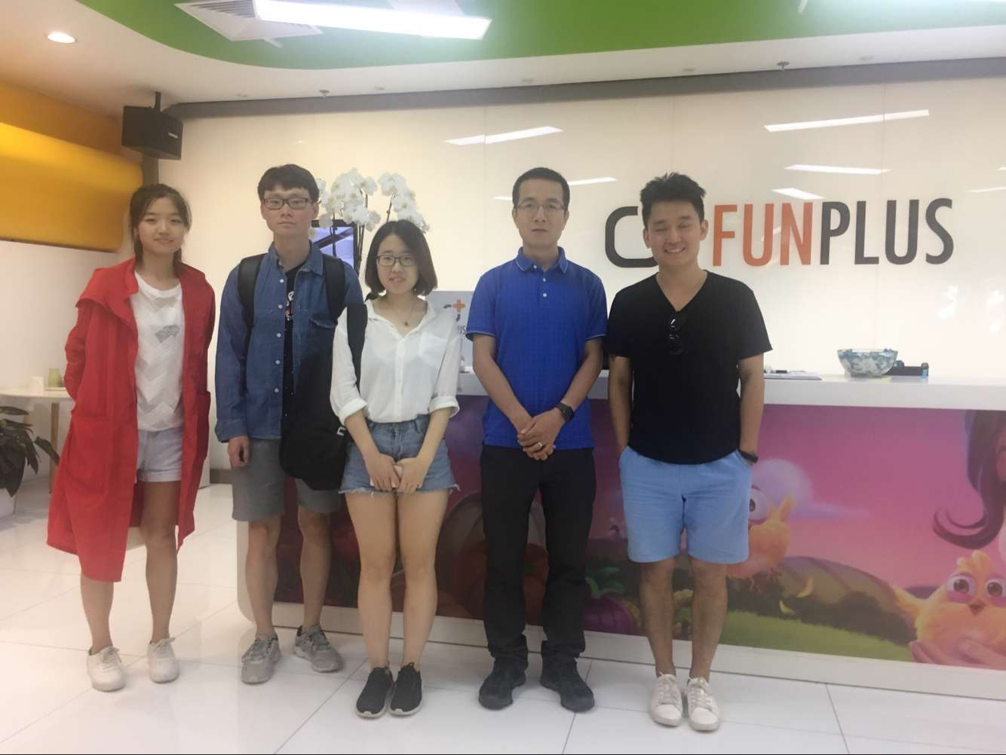
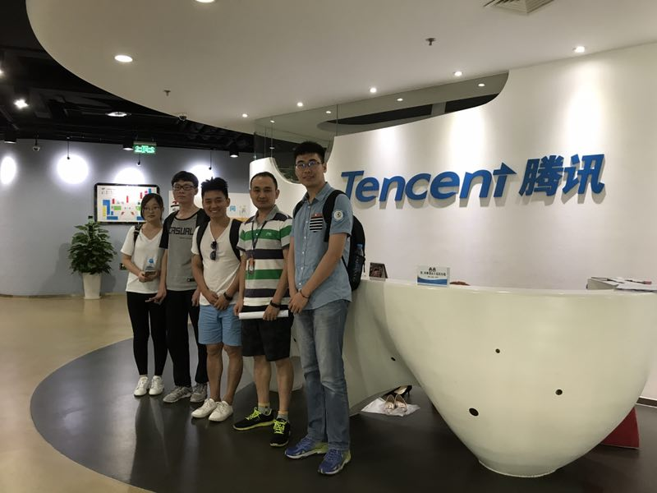
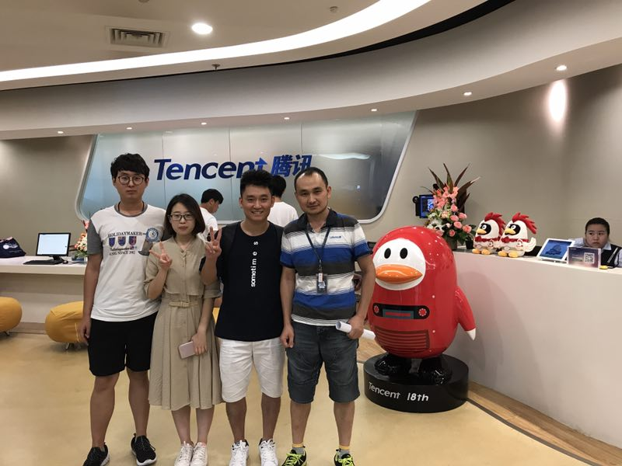
Dom Tech
多米科技
Share
Create
Learn

